Slide 1
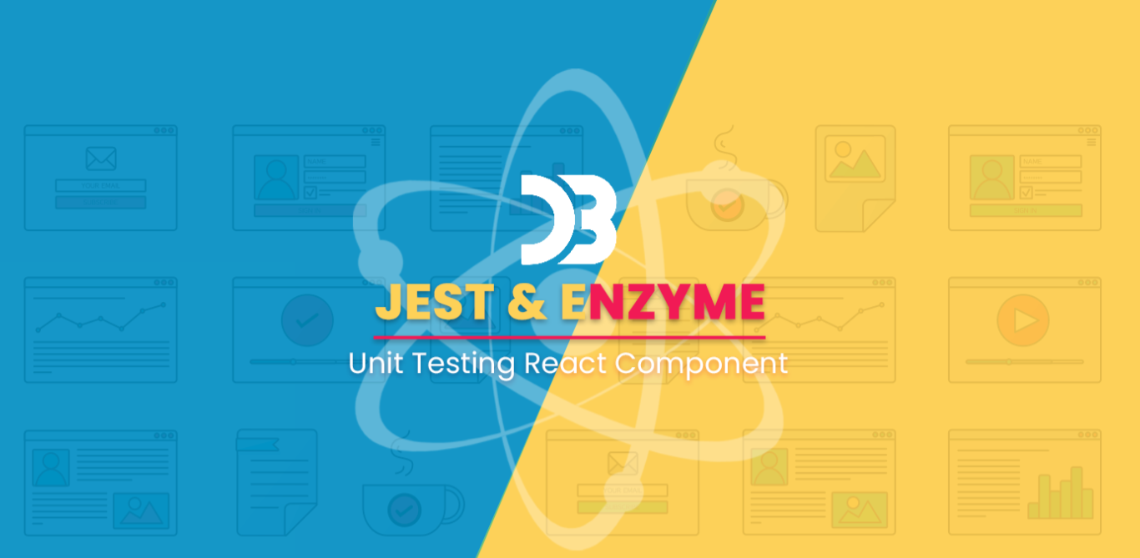

Slide 2
Unit testing
It is an essential and integral part of the software development process that helps us ensure the product’s stability.
It is the level of testing at which every component of the software is tested.
Significance of unit testing
It helps us improve the quality of code.
In a world of changing requirements, it helps us identify future breaks.
Since bugs are found early, it helps us reduce the cost of bug fixes.

Slide 3
Jest
Jest is a JavaScript unit testing framework, used by Facebook to test services and React applications.
Jest acts as a test runner, assertion library, and mocking library.
Jest also provides Snapshot testing, the ability to create a rendered ‘snapshot’ of a component and compare it to a previously saved ‘snapshot’.

Slide 4
Features of Jest
Zero Configuration
Fast and sandboxed
Extensible Framework
Mocking
Snapshot Testing
Jest is a complete testing framework that comes not only with a test runner, but also with its own assertion and mocking library. This means that, different from other testing frameworks, there is no need to install and integrate additional libraries to be able to mock, spy or make assertions.

Slide 5
Setup
Installing and configuring
Using CRA :
npx create-react-app jest-and-enzyme-demo
Install Jest:
npm add --dev jest babel-jest @babel/preset-env @babel/preset-react react-test-renderer

Slide 6
Jest is Fast!
Runs tests parallelly in processes to minimize test runtime.
Runs previously failed tests first.
Automatically finds tests related to changed files.
Easy to set up JavaScript testing solution.
Provides Test isolation i.e. no two tests will ever conflict with each other.
Jest works well with other testing libraries (example Enzyme, Chai).

Slide 7
Using Matchers
Jest uses matchers to test values in different ways.
Common Matchers
Numbers
Floating Numbers
Truthiness
Strings
Arrays

Slide 8
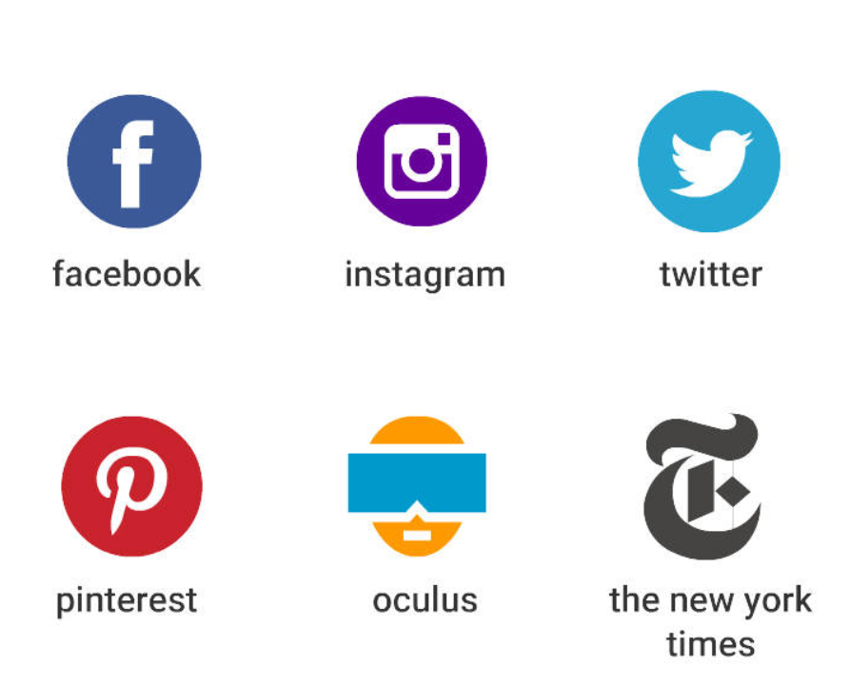
Who All Are Using Jest?
Jest is used by Leading companies to test web applications, node.js services, mobile apps, and APIs.

Slide 9

What is Enzyme?
Enzyme is a JavaScript Testing utility for React that makes it easier to assert, manipulate, and traverse your react Components’ output.
Enzyme, created by Airbnb, adds some great additional utility methods for rendering a component, finding elements, and interacting with elements.

Slide 10
Setup
Installing and configuring
Using CRA :
npx create-react-app jest-and-enzyme-demo
Install Enzyme:
npm install --save-dev enzyme enzyme-adapter-react-16 enzyme-to-json

Slide 11
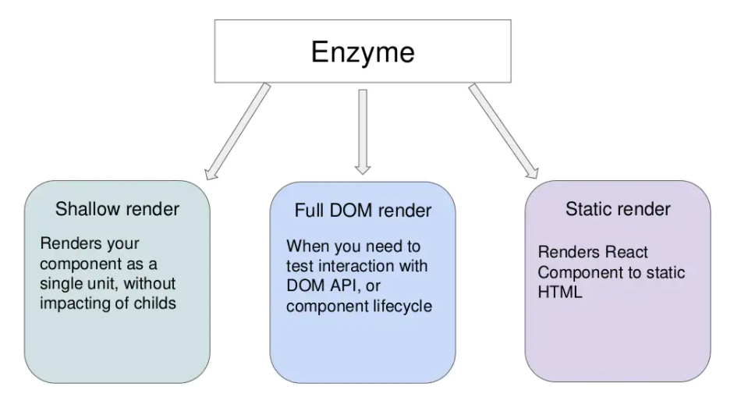

Slide 12
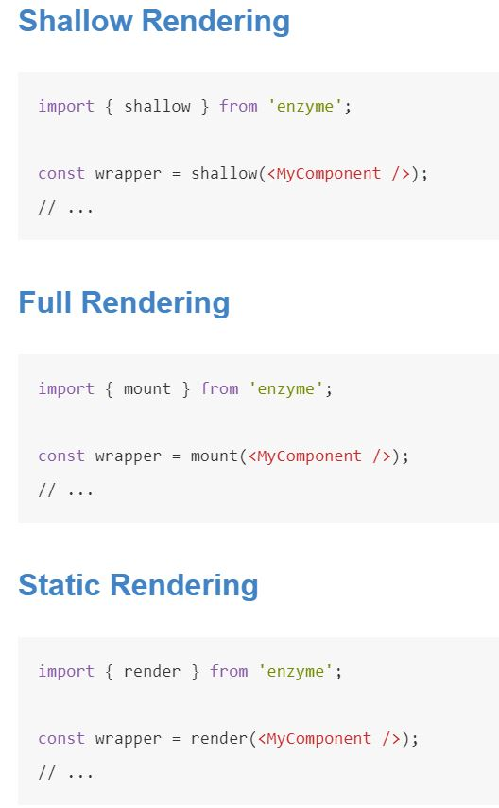
API Reference

Slide 13
Jest and Enzyme
Both Jest and Enzyme are specifically designed to test React applications, Jest can be used with any other JavaScript app but Enzyme only works with React.
Jest can be used without Enzyme to render components and test with snapshots, Enzyme simply adds additional functionality.
Enzyme can be used without Jest, however Enzyme must be paired with another test runner if Jest is not used.
Jest as the test runner, assertion library, and mocking library
Enzyme to provide additional testing utilities to interact with elements

Slide 14
Reference
https://reactjs.org/docs/getting-started.html
https://jestjs.io/
https://enzymejs.github.io/enzyme/
https://play.fresco.me/course/224/progress/topic/626/content/0

Slide 15
Thank You

